Slide 1
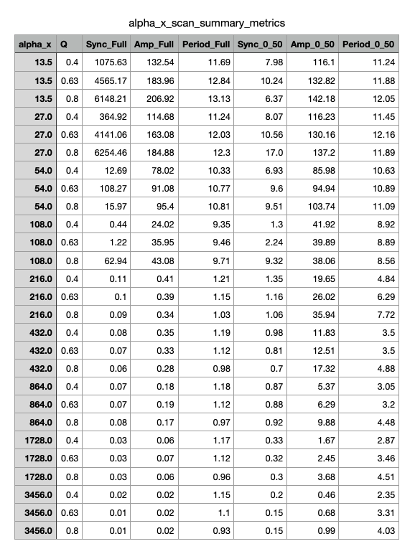
Summary Table From Alpha_X Parameter Scan

Slide 2
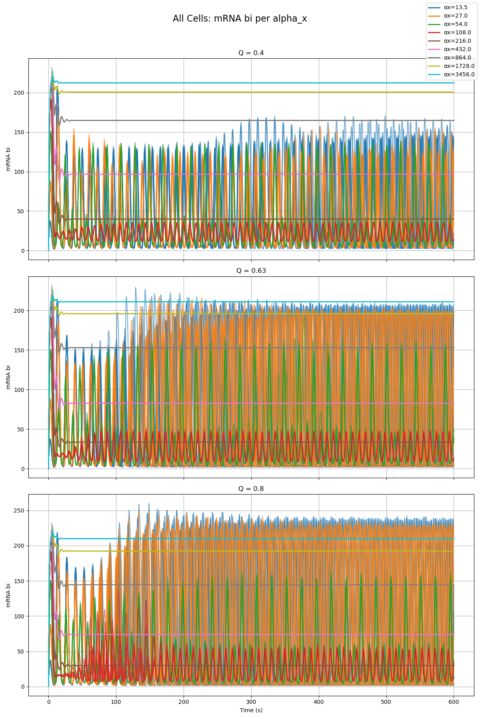
Combined Plot of All Cells and All Qs From Alpha_X Parameter Scan

Slide 3
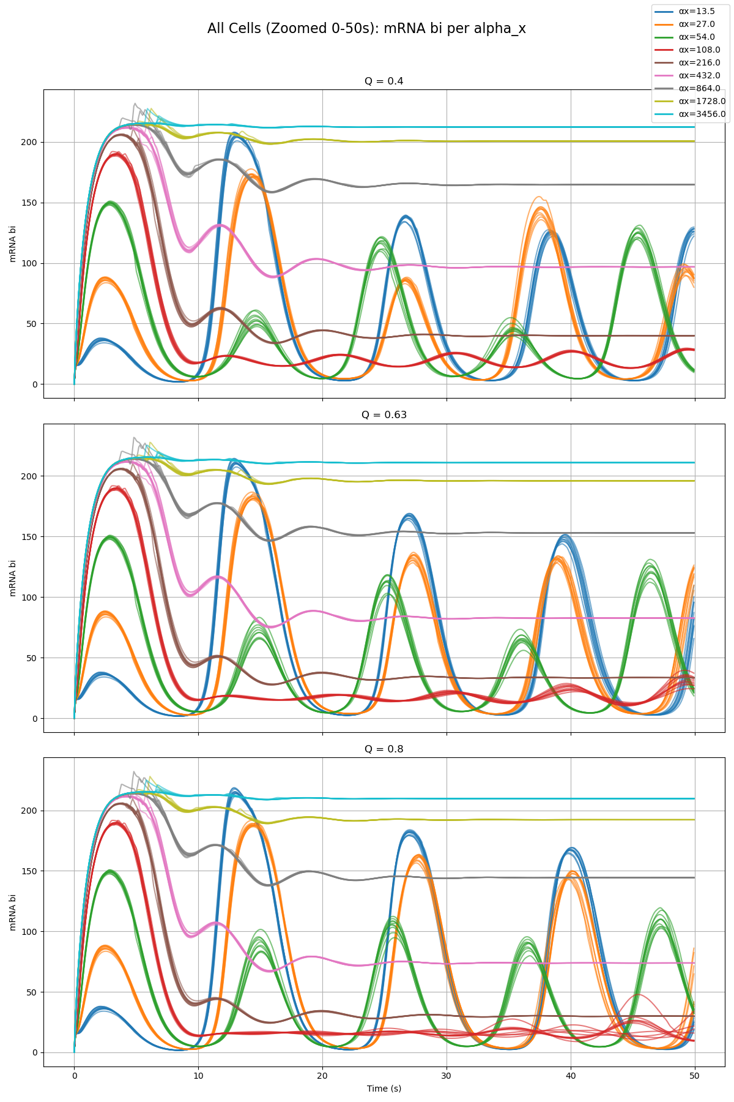
Combined Plot of All Cells and All Qs From Alpha_X Parameter Scan

Slide 4
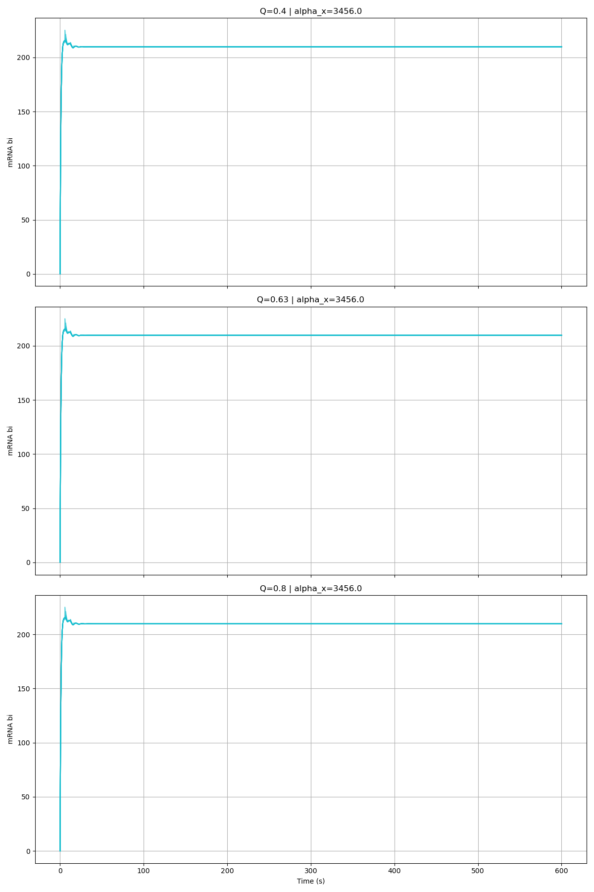
Alpha_X = 3456

Slide 5
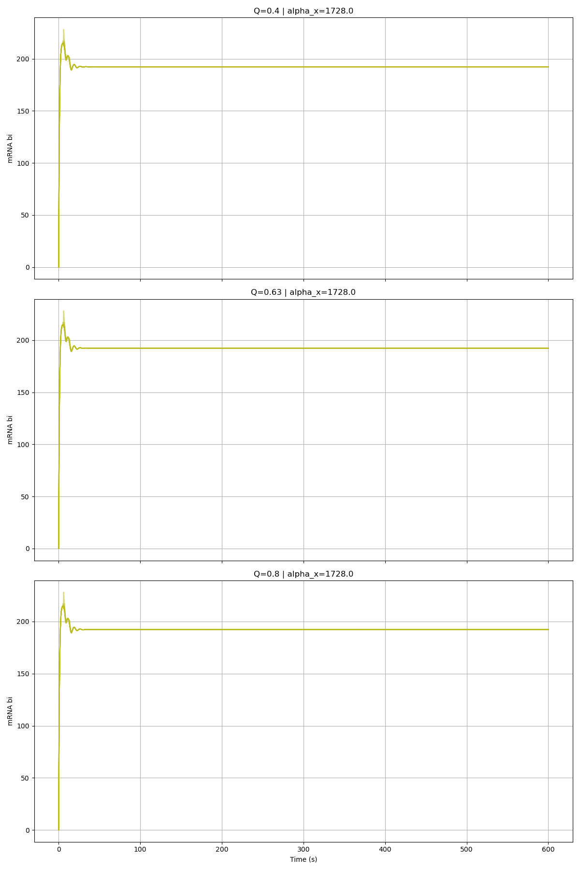
Alpha_X = 1728

Slide 6
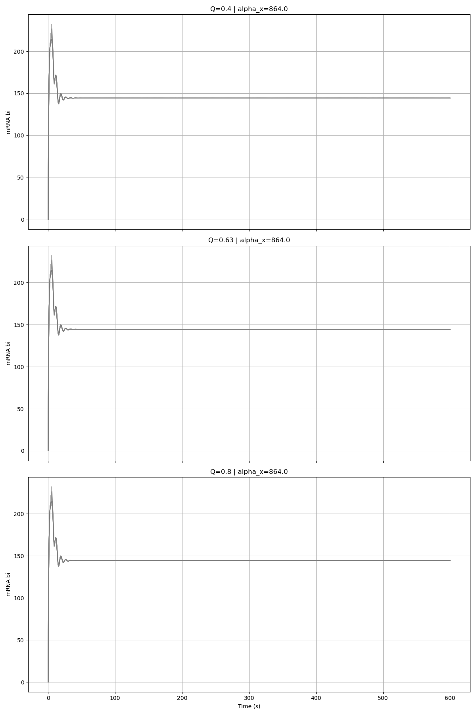
Alpha_X = 864

Slide 7
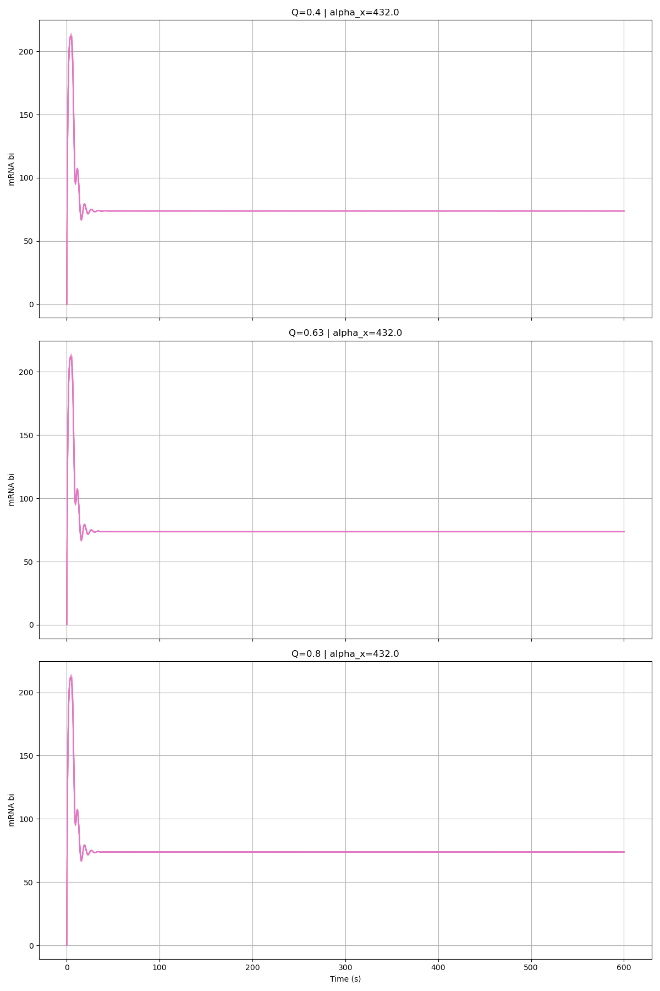
Alpha_X = 432

Slide 8
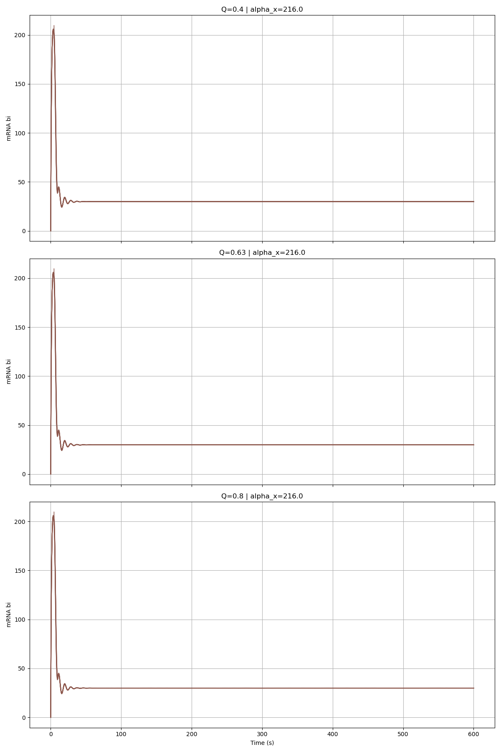
Alpha_X = 216

Slide 9
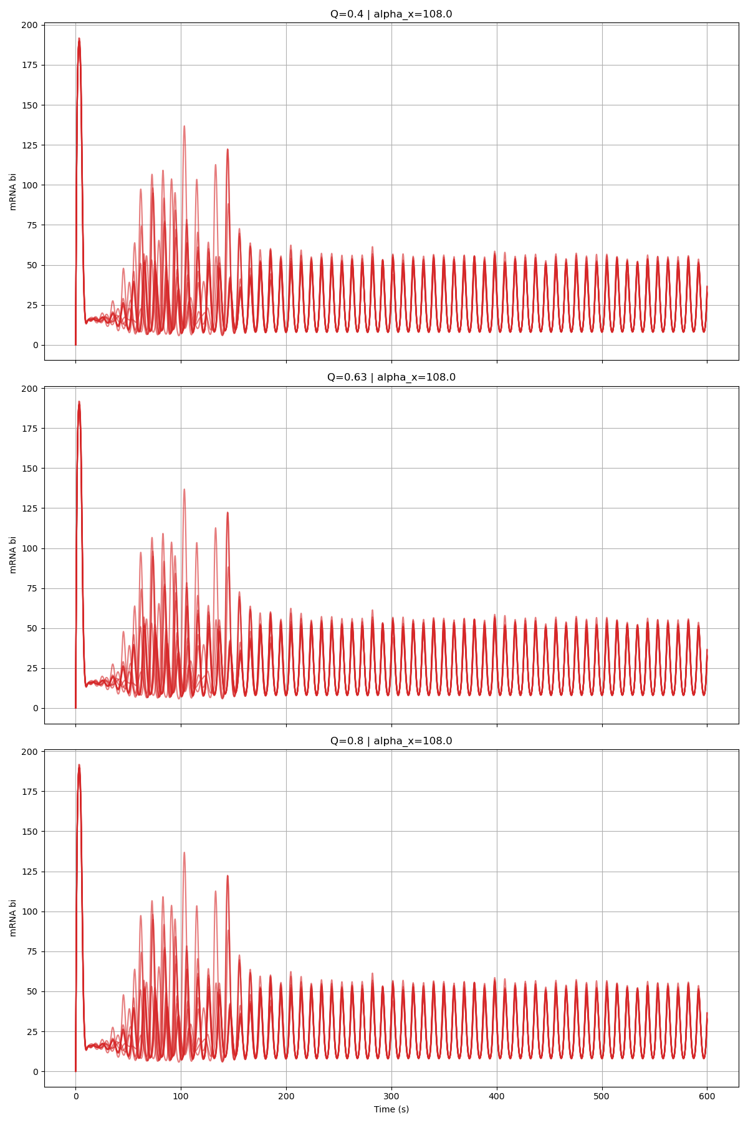
Alpha_X = 108

Slide 10
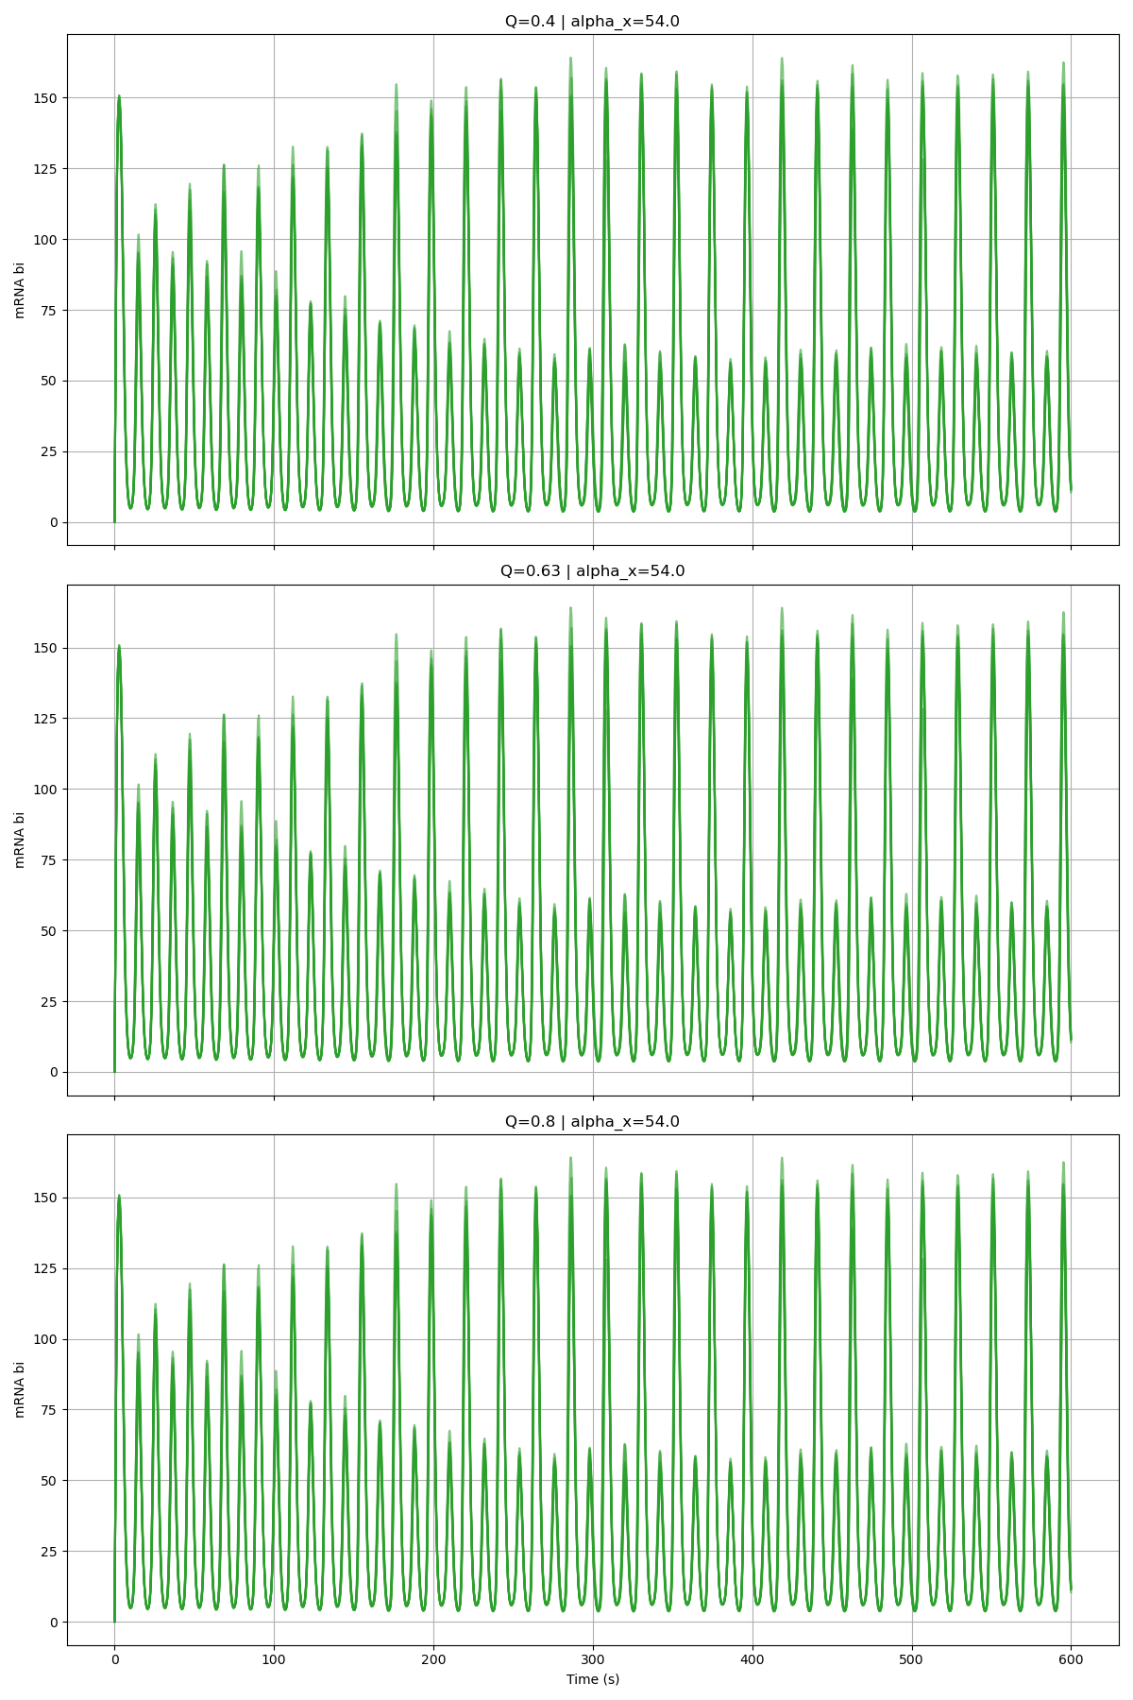
Alpha_X = 54

Slide 11
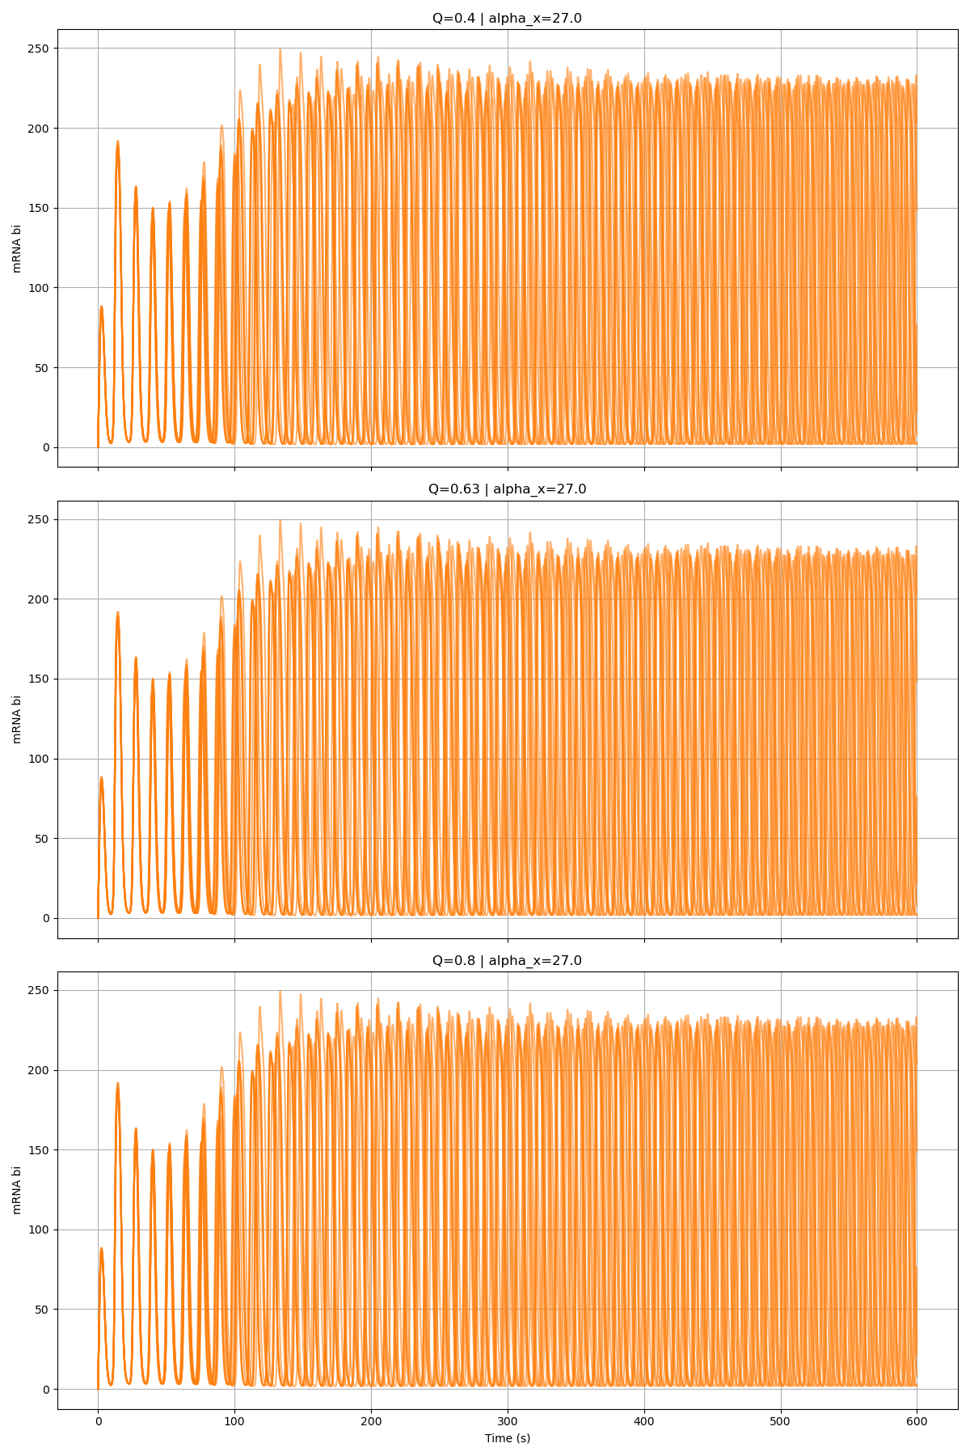
Alpha_X = 27

Slide 12
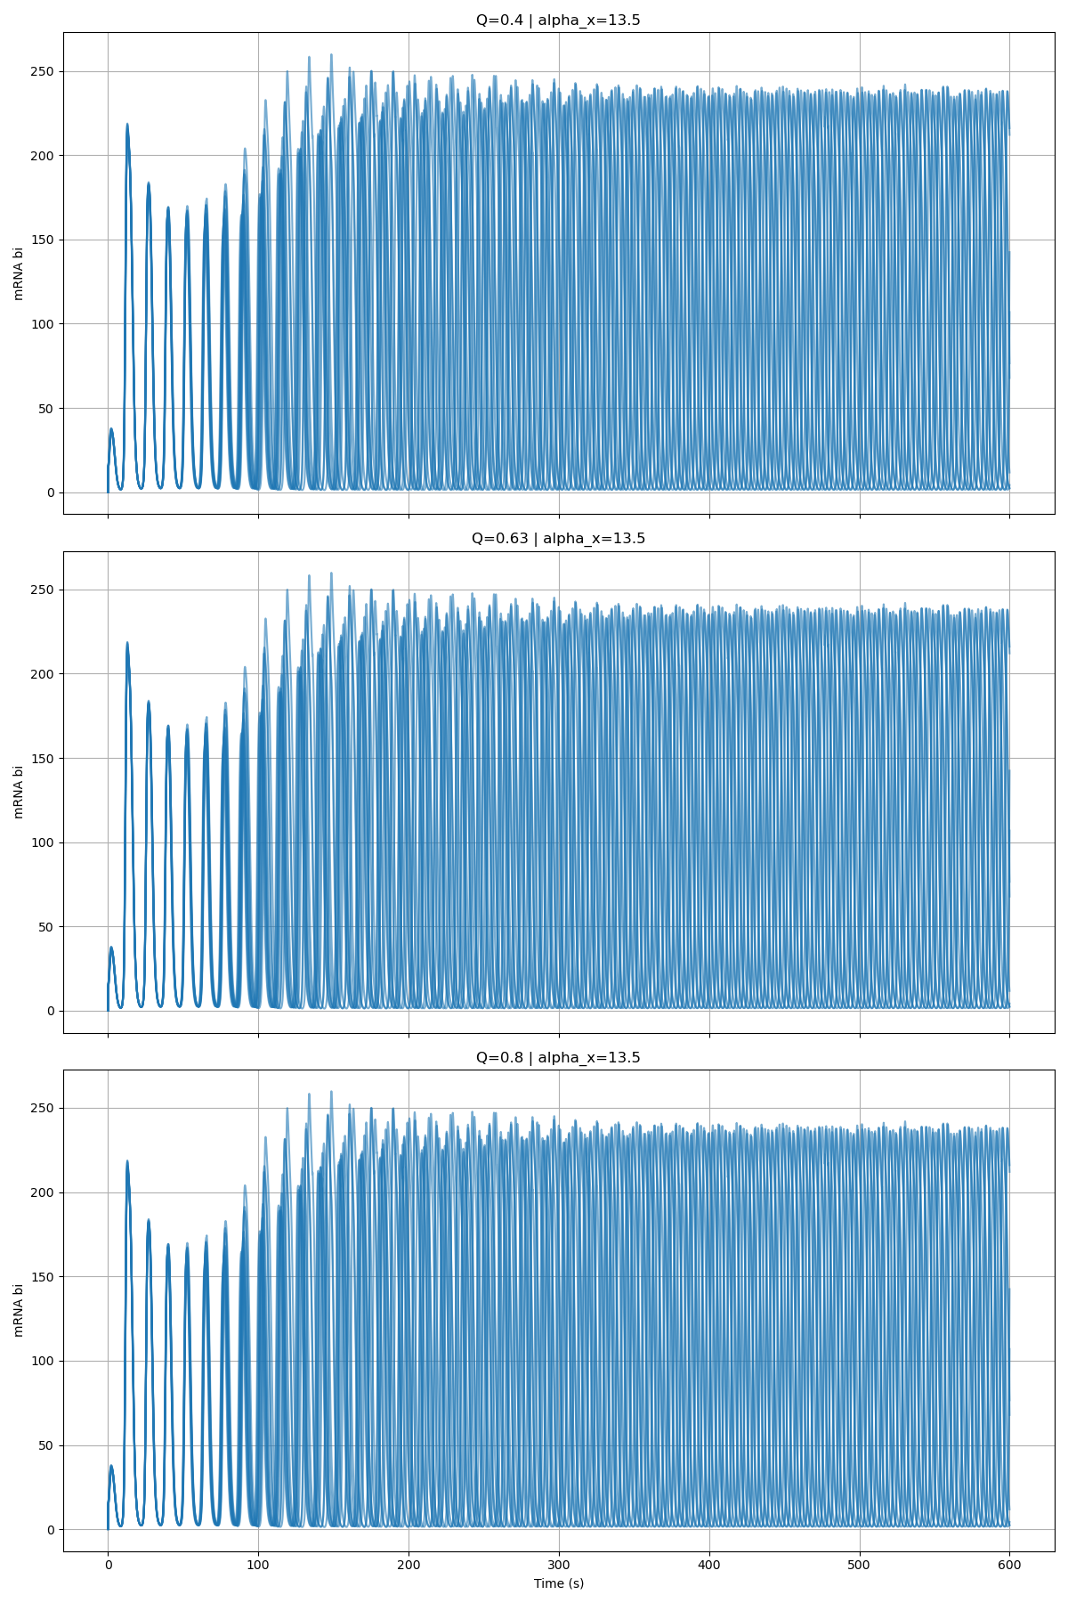
Alpha_X = 13.5

